Slide 1

Department of Computer Science and Engineering Optimizing the Powerhouse: Fine-Tuning CNNs for Superior Lung Disorder Detection Optimizing the Powerhouse: Fine-Tuning CNNs for Superior Lung Disorder Detection
PRESENTED BY
P.Tanuja
M.Mokshagna
V.Lavanya
(21471A05O2)
(21471A05N9)
(21471A05P5)
Under the Guidance of,
Rama Krishna Elluri _{Phd.,}
Assistant Professor,
Department of Computer Science and Engineering,
Narasaraopeta Engineering College (Autonomous), Narasaraopet- 522 601.
Review No.1
Department of CSE

Slide 2
OUTLINE
Abstract
Introduction
Literature Survey
Research Gaps
Problem Statement
Objectives
Block Diagram / Flow Diagram
Methodology
Implementation
Results and Analysis
Conclusion & Future Scope
References
Question and Answers
Acknowledgements
Review No.01
Department of CSE

Slide 3
ABSTRACT
This Project applies deep learning, particularly Convolutional Neural Networks (CNNs), for detecting lung diseases such as pneumonia, tuberculosis, and lung cancer using X-ray and CT scan images.
Pre-trained CNN models like VGG16 and VGG19 are fine-tuned to improve detection performance for lung disorders.
Data augmentation techniques, such as rescaling, flipping, and transforming, were utilized to improve model generalization and performance.
The model's performance is measured using key metrics such as precision, recall, and F1-score, ensuring a balance between accuracy and sensitivity.
Review No.01
Department of CSE

Slide 4
INTRODUCTION
Focus on using deep learning models, particularly Convolutional Neural Networks (CNNs), for detecting lung disorders like pneumonia, tuberculosis, and lung cancer.
The study analyzes chest X-ray and CT scan images to improve early disease diagnosis.
Utilizes popular CNN architectures such as VGG16 and VGG19.
Custom architectures are designed and combined with sequential and functional models to enhance detection accuracy.
The models demonstrated significant improvement in early detection performance, making them valuable in clinical settings.
Review No.
Department of CSE

Slide 5
LITERATURE SURVEY
No | Title | Author | Journal Name | Methodology Adapted | Key Findings | Gaps
1 | Lung Diseases Detection Using Various Deep Learning Algorithms | M. Jasmine Pemeena Priyadarsini,and Sharnil Pandya. | 2023 Innovations in Journal of Healthcare Engineering | The Functional Model allows flexible connections, and the Pretrained Model uses transfer learning with VGG-16. | F1 Score: 98.55%, Accuracy: 98.43%, Recall: 96.33%. | Limited exploration of optimizer types and learning rate variations.
2 | Predicting Lung Disease Severity via Image-Based AQI Analysis Using Deep Learning Techniques | Anvita Mahajan, Sayali Mate, Chinmayee Kulkarni, and Prof. Suraj Sawant. | Published as an arXiv Preprint on May 8, 2024. | The methodology includes VGG16 for feature extraction, a custom neural network for AQI prediction, and KNN and SVC models for lung disease. | The integrated approach successfully predicts AQI and assesses lung disease. | Scope to explore advanced deep learning models, such as transfer learning and hybrid architectures.
3 | Early Detection of Lung Cancer Using Machine Learning Technique | B. Devananda Rao,Dr. Mahammad Arshad | 2023 (ICCCI) | Utilization of CNNs for identifying cancer cells in CT images and staging lung cancer. | The proposed framework enhances the accuracy of lung cancer detection. | The study acknowledges that the vast database of images may lead to longer processing times
4 | Examine Lung Disorders and Disease Classification using Advanced CNN Approach | Jailsingh Bhookya | 3rd Asian Conference on Innovation in Technology (ASIANCON) | Training of the CNN model on a custom dataset comprising images of COVID-19 | The model effectively categorized chest X- ray images | Flight ticket pricing not only significantly impacts airlines
5 | Pricing Game of Flight Ticket Using Reinforcement Learning | Chenglong Cao; Xiaoling Zhu | ICTC 2024 Shar | ticket pricing, sequential game, reinforcement learning | By analyzing the convexity of the utility function | Flight ticket pricing not only significantly impacts airlines
28-12-2024
Review No.1
Batch No.DG4

Slide 6
LITERATURE SURVEY
No | Title | Author | Journal Name | Methodology Adapted | Key Findings | Gaps
6 | A Contemporary Technique for Lung Disease Prediction using Deep Learning | V Pradyotan Raju, Senduru Srinivasulu, P Vishnu. | ICAAIC Conference Proceedings Share | Data collection from various lung X-ray datasets, including normal and diseased images. | Achieved a test accuracy of 91% in predicting lung diseases from X-ray images. | Need for further research to enhance model robustness and generalizability in clinical settings.
7 | Lung Disease Detection using Deep Learning Techniques | Syed Krar Haider Bukhari, Labiba Fahad | ICET in the year 2022 | Utilized deep learning techniques, particularly CNNs, for classifying lung diseases. | Highlighted the challenges of high intra-class and low inter-class variations in lung disease images. | The study primarily focused on a limited number of lung diseases, suggesting a need for broader classification capabilities.
8 | Lung Disease Diagnosis using Machine Learning Techniques | Rajaselvi V, Sanjith J, Samuel Koshy | ICACITE in the year 2022 | Reviewed machine learning algorithms for lung disease diagnosis. | Reduced detection time and manual effort | Limited datasets and generalizability issues.
9 | Predicting Lung Disease Severity via Image-Based AQI Analysis Using Deep Learning Techniques | Anvita Mahajan, Sayali Mate, Chinmayee . | Preprint in the year 2023 | Integrated approach using VGG16 for feature extraction and neural networks for predicting AQI and lung disease severity | Achieved 87.44% accuracy for AQI prediction and 97.5% for lung disease severity | Focused on India with plans for global expansion and future enhancements using transfer learning
10 | Automated Pneumonia Based Lung Diseases Classification | Yaman Akbulut | Diagnostics in the year 2022 | Proposed a customized deep learning model (ACL) using attention and LSTM with CNN | Achieved 100% accuracy for 90-10% training-test ratio | Need for verification with diverse datasets for reliability.

Slide 7
RESEARCH GAPS
1. Limited Dataset Diversity
Most studies utilize a limited number of datasets, primarily from specific regions or hospitals.
There is a need for more diverse datasets that include various demographics, geographic locations, and imaging techniques.
2.Generalization of Models
Current models may not generalize well across different populations or imaging devices.
Research is needed to develop models that can adapt to variations in imaging quality and patient characteristics.
Review No.01
Department of CSE

Slide 8
3.Real-time Implementation and Scalability
Many proposed models are not tested in real-time clinical settings or lack scalability for widespread use.
Research is needed to evaluate the feasibility of deploying these models in clinical environments, including considerations for computational resources and integration with existing healthcare systems.
4.Addressing Class Imbalance
Many datasets suffer from class imbalance, particularly in rare diseases like certain types of lung cancer.
There is a need for techniques that effectively address class imbalance to improve model performance across all classes.

Slide 9
PROBLEM STATEMENT
The early and accurate detection of lung diseases such as pneumonia, tuberculosis, and lung cancer is critical to improving patient outcomes and reducing mortality rates. However, existing diagnostic methods often depend on manual interpretation of medical images, which is time-consuming, prone to error, and limited by the availability of skilled radiologists, particularly in rural areas. Conventional deep learning approaches for automated diagnosis face challenges such as limited dataset diversity, imbalanced class distributions, computational inefficiencies, and poor performance with rotated or noisy images. This calls for optimized, robust, and interpretable models capable of addressing these limitations to enable reliable and scalable deployment in clinical settings.
Let me know if you’d like any adjustments!
28-12-2024 ReviewNo. 01 Batch No.DG4 Department of CSE

Slide 10
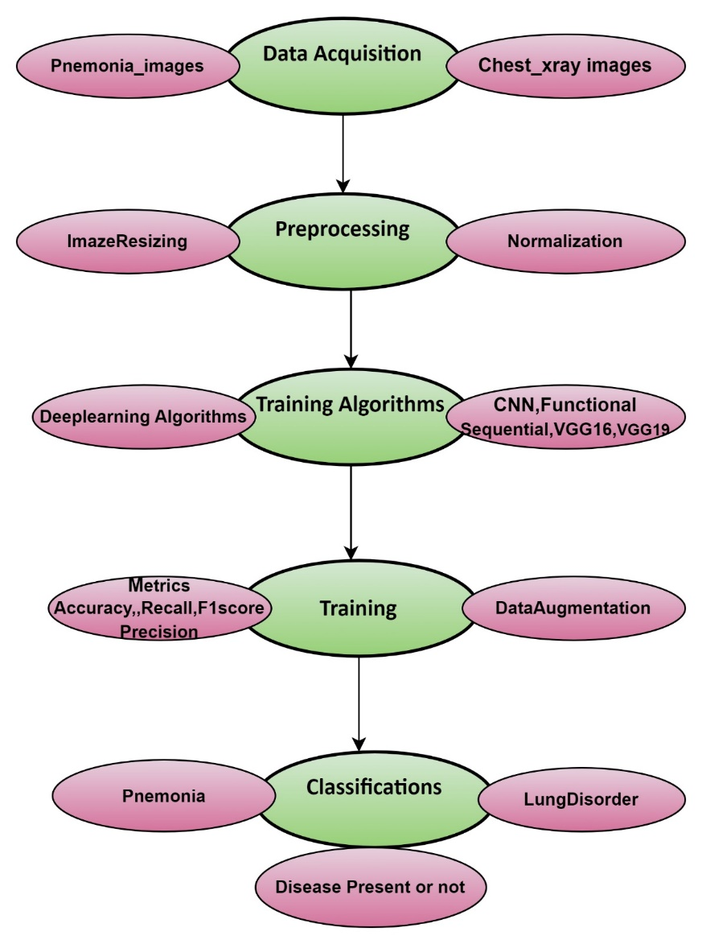
BLOCK DIAGRAM OR FLOW DIAGRAM
Review No.01
Department of CSE

Slide 11
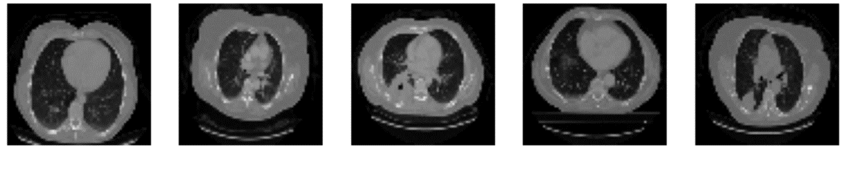
METHODOLOGY
Preprocessing Techniques:
1.Image Resizing:
Chest X-ray and CT scan images were resized to meet the input requirements of deep learning models such as VGG16, VGG19, and Functional/Sequential models.
Resizing ensured uniformity in image dimensions, allowing models to process data efficiently while preserving critical features.
2.Noise Removal:
Noise in the medical images, such as artifacts or irrelevant data, was reduced to improve the accuracy of disease detection.
Review No.01
Department of CSE

Slide 12
METHODOLOGY
3.Normalization:
Pixel intensity values were normalized to a range of 0 to 1 to accelerate model convergence and minimize bias caused by varying image brightness.
This step improved the model's ability to learn patterns effectively during training.
4.Data Augmentation:
Techniques like flipping, rotation, shearing, and scaling were applied to artificially increase the training dataset's size.
This reduced overfitting and improved the generalization ability of the models.
Review No.01
Department of CSE

Slide 13
Feature Extraction Procedure
The feature extraction process involved leveraging the deep features obtained from a pre-trained model's fully connected layers. These features were used as inputs for classification using a Logistic Regression model. The steps followed are detailed below:
Loading Extracted Features: The extracted features and corresponding labels were loaded from pre-saved files for further processing.
Label Encoding: The class labels were encoded into numerical format using LabelEncoder from scikit-learn. This step ensured compatibility with the Logistic Regression classifier.
Feature Scaling: To normalize the feature data, standard scaling was applied using StandardScaler. This transformation adjusted the feature values to have a mean of zero and a standard deviation of one, optimizing model performance.

Slide 14
4.Splitting the Dataset: The scaled features and encoded labels were split into training and testing sets, with 80% of the data used for training and 20% reserved for testing. The splitting ensured that the model was evaluated on unseen data.
5.Training the Logistic Regression Model: The model was then trained on the training dataset to classify the features.
6.Model Evaluation: The trained model was evaluated on the test dataset. Metrics such as accuracy and F1 score (weighted average) were calculated to assess the model’s performance. Additionally, a confusion matrix was generated to visualize prediction accuracy for each class.

Slide 15
Model Architecture
1.Convolutional Neural Network (CNN) Backbone
Purpose: The CNN is used as a feature extractor.It processes the input image through several convolutional layers to extract high-level features, such as edges, textures etc.
Layers:
Convolutional Layers: Several convolutional layers apply filters to the image, identifying low- and mid-level features.
Activation Function: Typically,ReLU (Rectified Linear Unit) activation is used to introduce non-linearity,allowing the network to learn more complex patterns.
Pooling Layers: Max pooling is often used to down sample the feature maps and reduce spatial dimensions, keeping the most essential features.
Batch Normalization: This normalizes the input to each layer to speed up training and improve convergence.

Slide 16
2.Sequential Model :
The Sequential model represents a straightforward, linear stack of layers where each layer has one input tensor and one output tensor.
Sequential models were utilized to classify lung diseases from chest X-ray and CT scan images.
Demonstrated efficient performance, especially on smaller datasets or cases requiring linear data flow.
3.Functional Model:
Unlike the Sequential model, the Functional model allows for complex architectures.
Represents the neural network as a directed acyclic graph, enabling branching and merging layers for advanced designs.
They demonstrated high performance in tasks like disease classification and pattern recognition.

Slide 17
4.VGG16 :
Oxford's Visual Geometry Group created the 16-layer deep Convolutional Neural Network known as VGG16. Thirteen convolutional layers and three fully linked layers utilizing tiny 3x3 filters made up this model. A nice thing about this concept is that, since it uses identical filter sizes all over, this concept makes it easy for user understanding and implementation. VGG16 is widely used for image classification tasks and has achieved high performance in benchmarks like ImageNet; though, it comes rather expensively due to depth and the number of parameters.
5.VGG19:
VGG19 is the extension of VGG16, comprising in total 19 layers: 16 convolutional and 3 fully connected. While VGG19 operates with the same characteristics as VGG16-it also uses small 3x3 filters-the presence of more convolutional layers makes it much deeper, hence much more capable of learning complex features from images. Accordingly, the computational burden and memory significantly rise with the fact that this network has become much deeper compared to VGG16. VGG19 has found extensive use in image classification, transfer learning, and feature extraction.

Slide 18

ACKNOWLEGEMENTS
Presented By
P.Tanuja (21471A05O2)
M.Mokshagna (21471A05N9)
V.Lavanya (21471A05P5)
Review No.01
Department of CSE

